Slide 1
Network security

Slide 2
Public-Key Cryptography and RSA

Slide 3
Introduction
Private/secret/single key (symmetric) systems, Key is shared by both sender and receiver.
Key must remain secret for it to be effective.
If the key is disclosed communications are compromised.

Slide 4
development of Public-Key Cryptography is the greatest revolution in the history of cryptography.
Normally all cryptographic systems have been based on the elementary tools of substitution and permutation.
But public-key algorithms are based on mathematical functions.
More important, it is asymmetric.

Slide 5
allow the key to be public but still protect the message.
Public key cryptosystem allow this goal by using two keys (private and public): one to encrypt and the other to decrypt.
Asymmetric encryption (public key cryptosystem) is a form of cryptosystem in which E and D are performed using the different keys.

Slide 6
Those who encrypt messages or verify signatures cannot decrypt messages or create signatures.

Slide 7
Those who encrypt messages or verify signatures cannot decrypt messages or create signatures.
Public-key, which may be known by anybody, and can be used to encrypt messages, and verify signatures
Private-key, known only to the recipient, used to decrypt messages, and sign (create) signatures
Much of the theory of Public-Key Cryptosystems is based on number theory.

Slide 8
Motivation
Why should making the key public be desirable?
Symmetric key system, each pair of users needs a separate key.
But with Asymmetric key systems, anyone using a single public key can send a secret message to a user.
In general, an n-user system requires n*(n-1)/2 keys.
Each user must track and remember a key for each other.
As the number of users grows, the number of keys increases rapidly.
Determining and distributing these keys is a problem.

Slide 9
Principles of Public-Key Cryptosystems
The concept of Public-Key Cryptography evolved from an attempt to attack two of the most difficult problems associated with symmetric encryption.
Key distribution under symmetric encryption requires either
  (1) that two communicants already share a key, which somehow has been distributed to them;
  (2) the use of a key distribution center.

Slide 10
Diffie, reasoned that this second requirement negated the very essence of cryptography: the ability to maintain total secrecy over your own communication.
Second problem that Diffie pointed that, it was apparently unrelated to the first was that of “Digital signatures.”
If the use of cryptography were to become widespread, then electronic messages and documents would need the equivalent of signatures used in paper documents.
Diffie and Hellman achieved great breakthrough in 1976 by coming up with a method that addressed both problems.
It was radically different from all the previous approaches to cryptography.

Slide 11
History of Public-Key Cryptography
Diffie and Hellman first publicly introduced the concepts of Public-Key Cryptography in 1976. However, this is not true beginning.
Admiral Bobby Inman, While director of the NSA, claimed that Public-Key Cryptography had been discovered at NSA in the mid of 1960.
The first documented introduction of these concepts came in 1970, from the Communications-Electronics Security Group , Britain by James Ellis.

Slide 12

Public-Key Cryptosystems
Public-Key algorithms rely on one key for encryption and a different but related key for decryption.

Slide 13
Detail about 5 ingredients of the Asymmetric cipher model
Plaintext: Original intelligible message fed as input to the algorithm.
Encryption algorithm: performs various transformations on plaintext
Public and Private key: This is a pair of keys that have been selected so that if one is used for E, the other is used for D. Exact transformations used in encryption algorithm depend on the public or private key.

Slide 14
Ciphertext: scrambled message produced as output. It depends on the plain text and the secret key. For a given message, two different keys will produce two different ciphertexts.
Decryption algorithm: accepts the ciphertext and the matching key and produces the original plaintext.

Slide 15
Essential steps for the Public-Key Cryptosystems
Each user generates a pair of keys to be used for the E and D of messages.
Each user places one of the 2 keys in a public register or other accessible file. This is the public key. The companion key is kept private.

Slide 16
In the figure, each user maintains a collection of public keys obtained from others.
If Bob wishes to send a confidential message to Alice, Bob encrypts the message using Alice’s public key.

Slide 17
When Alice receives the message, she decrypts it using her private key. No other recipient can decrypt the message.
With this approach, all participants have access to public keys, and private key are generated locally by each participant and therefore need never be distributed.

Slide 18
As long as system controls its private key, its incoming communication is secure.
At any time, a system can change its private key and publish the companion public key to replace its old public key.

Slide 19
Public-Key Characteristics
Public-Key algorithms rely on two keys with the characteristics that it is:
  computationally infeasible to find decryption key knowing only algorithm & encryption key
  computationally easy to en/decrypt messages when the relevant (en/decrypt) key is known
  either of the two related keys can be used for encryption, with the other used for decryption (in some schemes)
Notes:
Public key schemes utilise problems that are easy (P type) one way but hard (NP type) the other way, eg exponentiation vs logs, multiplication vs factoring. Consider the following analogy using padlocked boxes: traditional schemes involve the sender putting a message in a box and locking it, sending that to the receiver, and somehow securely also sending them the key to unlock the box. The radical advance in public key schemes was to turn this around, the receiver sends an unlocked box to the sender, who puts the message in the box and locks it (easy - and having locked it cannot get at the message), and sends the locked box to the receiver who can unlock it (also easy), having the key. An attacker would have to pick the lock on the box (hard).

Slide 20
Comparison between Symmetric and Asymmetric key Cryptography
Asymmetric key Cryptography solves the problem of key agreement and key exchange.
However, this does not solve all the problems in a practical security infrastructure.
Symmetric key cryptography is based on sharing secrecy.
Asymmetric key cryptography is based on personal secrecy.
Symmetric key cryptography, symbols are permuted and substituted.
Asymmetric key cryptography, numbers are manipulated

Slide 21
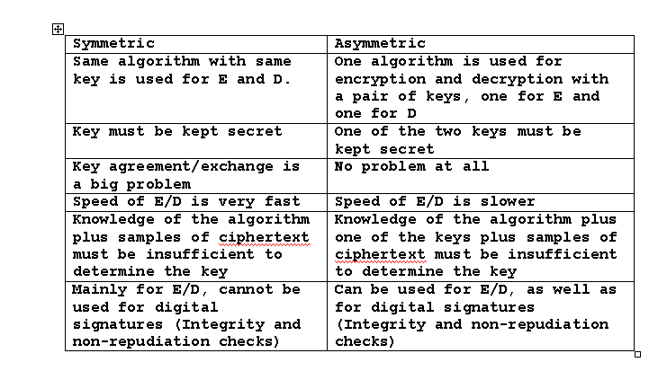
Table shown 5.1 summarizes some of the important aspects of symmetric and public-key encryption

Slide 22
Notation used in Public-Key Cryptosystems
A public key is represented by PU_{a},
Corresponding private key is PR_{a}.

Slide 23
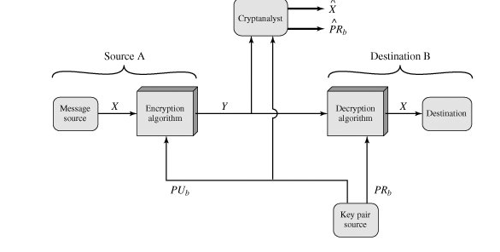
Essential elements of a public-key encryption scheme

Slide 24
Some source A produces a message in plain text, X= [X₁, X2,…,Xm].
The M elements of X are letters in some finite alphabet.
The message is intended for destination B.
B generates a related pair of keys: a public key PU_{b}, and a private key, PR_{b}.

Slide 25
PR_{b} is known only to B, where as PU_{b} is publicly available and therefore accessible by A.
With the message X and the encryption key PU_{b} as input, A forms the ciphertext Y = [Y₁,Y₂,…Y_{n}].
Y = E (PU_{b,} X)

Slide 26
Receiver, in possession of the matching private key, is able to invert the transformation:
      X = D (PR_{b}, Y)
An opponent, observing Y and having access to PU_{b} but not having access to PR_{b} or X, may attempt to recover X and/or PR_{b}.

Slide 27
An opponent, observing Y and having access to PU_{b} but not having access to PR_{b} or X, may attempt to recover X and/or PR_{b}.
It is assumed that the adversary does have knowledge of the encryption (E) and decryption (D) algorithms.
If the adversary is interested only in this particular message, then the focus of effort is to recover X, by generating a plaintext estimate X^ Often.

Slide 28
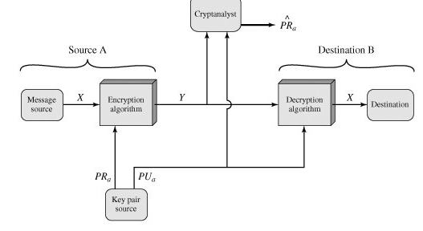
Public-Key Cryptosystem: Authentication
  Y = E (PR_{a} ,X)
  X = D (PU_{b}, Y)

Slide 29
Because the message was encrypted using A’s private key, only A could have prepared the message. Therefore, the entire encrypted message serves as a Digital signature.
In addition, it is impossible to alter the message without access to A’s private key, so the message is authenticated both in term of source and in terms of data integrity.

Slide 30
Public-Key Cryptosystem: Authentication and Secrecy
In PKC (Authentication), the message being sent is safe from alteration but not from eavesdropping.
Previous figure, there is no protection of confidentiality because any observer can decrypt the message by using the sender's public key.
It is possible to provide both the authentication function and confidentiality by a double use of the public-key scheme.

Slide 31

Z = E(PU_{b}, E(PR_{a}, X))
X = D(PU_{a}, E(PR_{b}, Z))
Notes:
Stallings Fig 9.4
Here see various components of public-key schemes used for both secrecy and authentication. Note that separate key pairs are used for each of these – receiver owns and creates secrecy keys, sender owns and creates authentication keys.

Slide 32
Public-Key Applications
can classify uses into 3 categories:
  encryption/decryption (provide secrecy)
  digital signatures (provide authentication)
  key exchange (of session keys)
some algorithms are suitable for all uses, others are specific to one

Slide 33
